Slide 1
Digital Image Processing
IT-I Semester, 2010-11
Prof. Suresh Pabboju
IT Dept., CBIT, Hyd

Slide 2
Some
Basic Relationships
between Pixels
Prof. Suresh Pabboju, IT Dept, CBIT, Hyd

Slide 3
Some Basic Relationships Between Pixels
Definitions:
  f(x,y): digital image
  Pixels: p, q
  Subset of pixels of f(x,y): S
Prof. Suresh Pabboju, IT Dept, CBIT, Hyd

Slide 4
Neighbors of a Pixel
A pixel p at (x,y) has 2 horizontal and 2 vertical neighbors:
  (x+1,y), (x-1,y), (x,y+1), (x,y-1)
  This set of pixels is called the 4-neighbors of p: N₄(p)
Prof. Suresh Pabboju, IT Dept, CBIT, Hyd

Slide 5
Neighbors of a Pixel
The 4 diagonal neighbors of p are: (N_{D}(p))
  (x+1,y+1), (x+1,y-1), (x-1,y+1), (x-1,y-1)
N₄(p) + N_{D}(p) → N₈(p): the 8-neighbors of p
Prof. Suresh Pabboju, IT Dept, CBIT, Hyd

Slide 6
Connectivity
Connectivity between pixels is important:
  Because it is used in establishing boundaries of objects and components of regions in an image
Prof. Suresh Pabboju, IT Dept, CBIT, Hyd

Slide 7
Connectivity
Two pixels are connected if:
  They are neighbors (i.e. adjacent in some sense -- e.g. N₄(p), N₈(p), …)
  Their gray levels satisfy a specified criterion of similarity (e.g. equality, …)
V is the set of gray-level values used to define adjacency (e.g. V={1} for adjacency of pixels of value 1)
Prof. Suresh Pabboju, IT Dept, CBIT, Hyd

Slide 8
Adjacency
We consider three types of adjacency:
  1) 4-adjacency: two pixels p and q with values from V are 4-adjacent if q is in the set N₄(p)
  2) 8-adjacency : p & q are 8-adjacent if q is in the set N₈(p)
Prof. Suresh Pabboju, IT Dept, CBIT, Hyd

Slide 9
Adjacency
The third type of adjacency:
  3) m-adjacency: p & q with values from V are m-adjacent if
    q is in N₄(p) or
    q is in N_{D}(p) and the set N₄(p)∩N₄(q) has no pixels with values from V
Prof. Suresh Pabboju, IT Dept, CBIT, Hyd

Slide 10
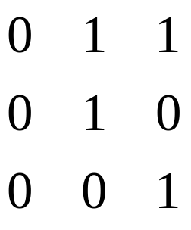
Adjacency
Mixed adjacency is a modification of 8-
adjacency and is used to eliminate the multiple path connections that often arise when 8-adjacency is used.
Prof. Suresh Pabboju, IT Dept, CBIT, Hyd

Slide 11
Adjacency
Two image subsets S1 and S2 are adjacent if some pixel in S1 is adjacent to some pixel in S2.
Prof. Suresh Pabboju, IT Dept, CBIT, Hyd

Slide 12
Path
A path (curve) from pixel p with coordinates (x,y) to pixel q with coordinates (s,t) is a sequence of distinct pixels:
  (x₀,y₀), (x₁,y₁), …, (x_{n},y_{n})
  where (x₀,y₀)=(x,y), (x_{n},y_{n})=(s,t), and (x_{i},y_{i}) is adjacent to (x_{i-1},y_{i-1}), for 1≤i ≤n ; n is the length of the path.
If (xo, yo) = (xn, yn): a closed path
Prof. Suresh Pabboju, IT Dept, CBIT, Hyd

Slide 13
Paths
4-, 8-, m-paths can be defined depending on the type of adjacency specified.
If p,q  S, then q is connected to p in S if there is a path from p to q consisting entirely of pixels in S.
Prof. Suresh Pabboju, IT Dept, CBIT, Hyd

Slide 14
Connectivity
For any pixel p in S, the set of pixels in S that are connected to p is a connected component of S.
If S has only one connected component then S is called a connected set.
Prof. Suresh Pabboju, IT Dept, CBIT, Hyd

Slide 15
Boundary
R a subset of pixels: R is a region if R is a connected set.
Its boundary (border, contour) is the set of pixels in R that have at least one neighbor not in R
Edge can be the region boundary (in binary images)
Prof. Suresh Pabboju, IT Dept, CBIT, Hyd

Slide 16
Distance Measures
For pixels p,q,z with coordinates (x,y), (s,t), (u,v), D is a distance function or metric if:
  D(p,q) ≥ 0 (D(p,q)=0 iff p=q)
  D(p,q) = D(q,p) and
  D(p,z) ≤ D(p,q) + D(q,z)
Prof. Suresh Pabboju, IT Dept, CBIT, Hyd

Slide 17
Distance Measures
Euclidean distance:
  D_{e}(p,q) = [(x-s)² + (y-t)²]^{1/2}
  Points (pixels) having a distance less than or equal to r from (x,y) are contained in a disk of radius r centered at (x,y).
Prof. Suresh Pabboju, IT Dept, CBIT, Hyd

Slide 18
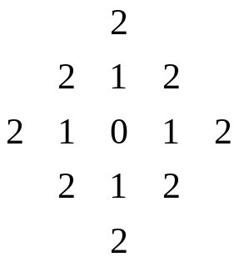
Distance Measures
D₄ distance (city-block distance):
  D₄(p,q) = |x-s| + |y-t|
  forms a diamond centered at (x,y)
  e.g. pixels with D₄≤2 from p
D₄ = 1 are the 4-neighbors of p
Prof. Suresh Pabboju, IT Dept, CBIT, Hyd

Slide 19
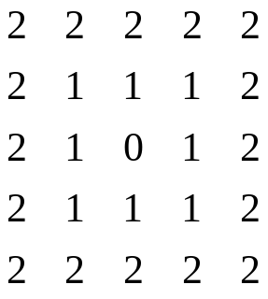
Distance Measures
D₈ distance (chessboard distance):
  D₈(p,q) = max(|x-s|,|y-t|)
  Forms a square centered at p
  e.g. pixels with D₈≤2 from p
D₈ = 1 are the 8-neighbors of p
Prof. Suresh Pabboju, IT Dept, CBIT, Hyd

Slide 20
Distance Measures
D₄ and D₈ distances between p and q are independent of any paths that exist between the points because these distances involve only the coordinates of the points (regardless of whether a connected path exists between them).
Prof. Suresh Pabboju, IT Dept, CBIT, Hyd

Slide 21
Distance Measures
However, for m-connectivity the value of the distance (length of path) between two pixels depends on the values of the pixels along the path and those of their neighbors.
Prof. Suresh Pabboju, IT Dept, CBIT, Hyd

Slide 22
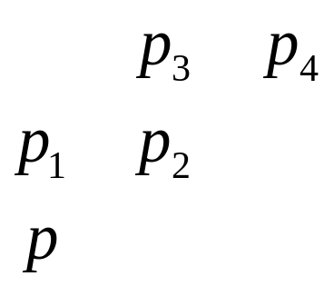
Distance Measures
e.g. assume p, p₂, p₄ = 1
p₁, p₃ = can have either 0 or 1
If only connectivity of pixels valued 1 is allowed, and p₁ and p₃ are 0, the m-distance between p and p₄ is 2.
If either p₁ or p₃ is 1, the distance is 3.
If both p₁ and p₃ are 1, the distance is 4 (pp1p2p3p4)
Prof. Suresh Pabboju, IT Dept, CBIT, Hyd

